Slide 1



J1-879 M: Optimization in Energy Networks
Special Topics in Systems and Control
Lecture 1
Dr. Yinliang Xu
SYSU-CMU Joint Institute of Engineering, Sun Yat-sen University
SYSU-CMU Shunde International Joint Research Institute

Slide 2
Contact Information
Office: School of software A204 (temporary)
Office hour: Wednesday 10 am-12 pm, or by appointment via email
Email: xuyliang@mail.sysu.edu.cn
Teaching assistant: Irfan Khan
Website: http://jie.sysu.edu.cn/~ylxu/
Course overview
Lecture Material: Slides (posted on blackboard)
Monday, 2:15 pm- 4:05 pm, @ A301 for Week 1-4, @ C501 for Week 5-16
Wednesday, 1:30 pm- 3:20 pm, @ A103 for Week 1-4, @ C401 for Week 5-16
Recitation: Friday (usually every two weeks, will be announced on every Monday), 1:30 pm- 2:20 pm (No Recitation this week) @ A103 for Week 1-4, @ C203 for Week 5-16

Slide 3
Textbook
No official textbooks, some books and research paper suggested are:
Computational Methods for Electric Power Systems, 2nd ed. by M. L. Crow, Boca Raton, FL: CRC, 2009
An introduction to optimization, 4th ed. by Edwin K. P. Chong and Stanislaw H. Zak, Wiley, 2013.
1. Y. Xu*. "Optimal Distributed Charging Rate Control of Plug-in Electric Vehicles for Demand Management," IEEE Trans. on Power Systems, IEEE Trans. on Power Systems, 2014, Accepted for publication.(SCI, IF:3.53)
2. Y. Xu*, Z. Li. "Distributed Optimal Resource Management based on Consensus Algorithm in a Microgrid," IEEE Trans. on Industrial Electronics, 2014, Accepted for publication. (SCI, IF:6.5)
3. Y. Xu*, W. Zhang, G. Hug, etc. "Cooperative Control of Distributed Energy Storage Systems in a Microgrid," IEEE Trans. on Smart Grid. 2014, Accepted for publication. (SCI, IF:4.334)

Slide 4
Textbook
4. Y. Xu, W. Zhang, W. Liu, etc. "Distributed Subgradient-Based Coordination of Multiple Renewable Generators in a Microgrid," IEEE Trans. on Power Systems, vol.29, no.1, pp.23-33, 2014.(SCI,IF:3.53)
5. Y. Xu, W. Zhang, and W. Liu, "Multi-agent based Reinforcement Learning for Optimal Reactive Power Dispatch," IEEE Trans. on Systems, Man, and Cybernetics--Part C: Applications and Reviews vol. 42, no. 6, pp. 1742-1751, 2012. (SCI,IF:1.526)
6. Y. Xu and W. Liu, "Stable Multi-agent Based Load Shedding Algorithm for Power Systems," IEEE Trans. on Power Systems, vol. 26, no. 4, pp. 2006-2014, 2011.(SCI,IF:3.53)
7. Y. Xu and W. Liu, "Novel Multi Agent Based Load Restoration Algorithm for Microgrids," IEEE Trans. on Smart Grid, vol. 2, no. 1, pp. 140-149, 2011.(SCI, IF=4.334)

Slide 5
Tests and Grading Criteria
Homework (20%)
Homework will be assigned approximately every 2 weeks.
Students are supposed to submit the homework within one week. 20% points will be deducted for late homework without an extension permit.
The lowest score for an assignment will not be considered to calculate the homework total score. However, all assignments need to be submitted in order to obtain a grade for the homework.
Course Project. (30%)
Project report (15%)
Project presentation (15%)
Maximum number of group members for the course project are two, individual project will get extra 10% points.

Slide 6
Tests and Grading Criteria
3. Midterm (20%) & Final Exam (30%)
Similar to homework questions
Closed book and closed notes, laptop and tablet are forbidden but one A4 cheat sheet and a simple calculator are allowed
4. Research paper –Optional (30%)
Students need to identify a topic related to energy system and get the approval from the instructor.
Write a research paper that can be submitted to a conference or journal.
Do not need to take the final exam. Or will get one of the higher score between the research paper and the final exam.
5. Quits (Bonus 10%)

Slide 7
What do I expect from you?
Active participation
Do all the homework sets
Read several research paper
Do a serious project
Present your project
What is the payoff?
Learn top research problems in energy system and smart grid area
Learn several mathematical tools, which will be useful for your future research
Improve programming skill

Slide 8
Pre-Requisites
Mathematics: Linear algebra, Calculus, Complex values, …
System Theory: Concept of system variables, input/output, state space representation, …
Electric Circuits: Voltage, current, impedance, power, Ohms and Kirchhoff laws, complex representation …
Matlab Programming

Slide 9
Course Contents
Power networks
Optimization for power systems
  Problem Setup
  Solution Techniques
  Matlab programming
Smart Grid
  Renewable generation integration
  Energy storage system
  Plug-in electric vehicle charging management
Electricity market
  Generation dispatch
  Demand response

Slide 10
Introduce Yourself
Name
Department (undergraduate)
Major
Why are you interested in this course, or what do you expect to learn from this course?

Slide 11
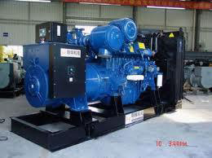
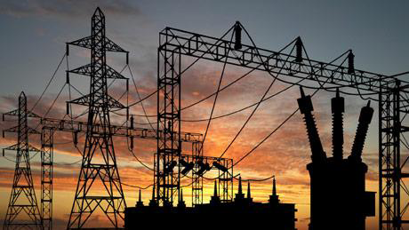
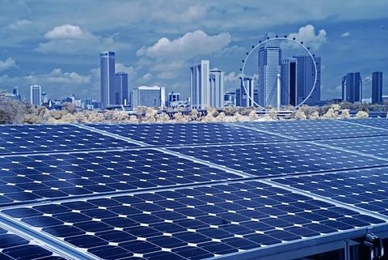
This course is about optimization in electric energy system
Fossil fuel generation
Power Grid
Renewable generation

Slide 12
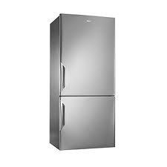
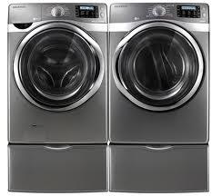


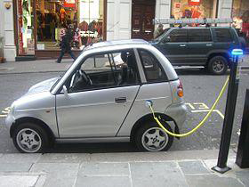
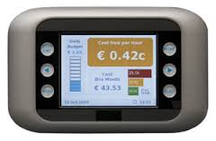
Loads
Transportation system
Smart meter

Slide 13
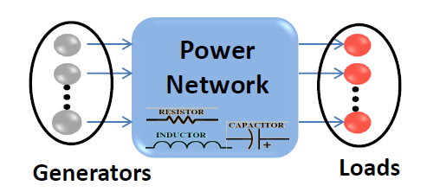
How to provide reliable and economical power to multiple loads with minimum expense?
There are several issues:
A single fault may lead to blackout
Every area needs a dedicated and reliable source of energy, which is expensive
Renewable energy is highly intermittent
Possible solutions:
Connect a group of generators and loads via physical network
High capacity energy storage system
Prediction techniques and advanced control algorithms

Slide 14


This seems to be really cool!
Reliability: A single fault may not cause blackout
Efficiency: Shared generators reduce costs
Economical: Less capital investment (infrastructure)
Eco-friendly: renewable energy integration
This is not the end of the story
Reliability: A fault may still propagate
Effectiveness: Bad coordination between components and areas would degrade the efficiency or even break down the network
Prediction or measurement error

Slide 15
Emerging challenges:
Gray energy is running out with increasing prices
Green house gas emission
Generation can not keep up with ever-growing demand
Legacy electricity network systems need upgrading
Possible solutions:
Increase penetration level of renewable energy
Optimize efficiency
Optimize reliability
If you’re interested in energy, this course is right for you.

Slide 16
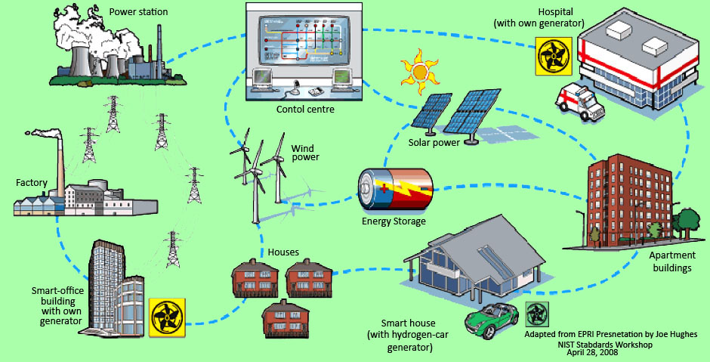
Smart grid
聪
Replace bulk generators with distributed generation units
Integrate renewable energy
Introduce energy management strategies (demand response, generation dispatch)
Introduce energy storage with large capacity and integrate electric vehicles.
Apply advanced control and optimization techniques

Slide 17
Course Objectives
At the end of the semester, the student should be able to:
formulate an optimization problem and derive the conditions which have to hold for the solution of the problem
apply the discussed methods to find the solution to an optimization problem
name advantages and disadvantages of the various approaches
apply the distributed strategies to large-scale systems such as power systems
implement your algorithm using some software for programming
understand simple models of PV system, wind turbine, energy storage system, plug-in electric vehicle.

Slide 18
What is optimization?
Goal: to achieve the optimal possible outcome in a given situation.
But:
What are the variable and state in the system? (hydropower)
  What does optimal mean?
  It might be defined differently by different people with different objectives.
  Are there any limitations to the solution?
  Usually, there are limitations/constraints which lead to sub-optimal outcomes.
  Variables, States, Objective and Constraints have to be defined.
Notes:
damn

Slide 19
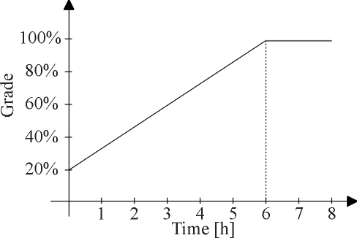
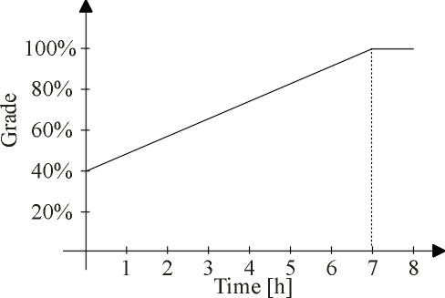
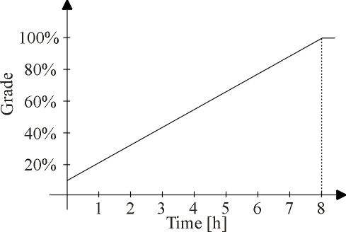
What is optimization?
  Example:
  3 tasks, total time available for preparing is 15 hours, learning curves are given as:
Exam 1: TOEFL
Exam 2: GRE
Exam 3: Study plan
Question: How much time should you spend for which task?

Slide 20
What is optimization?
Variables: study time for each task => 3 variables
grade for each task => 3 dependent variables
Objective: maximize total grade
Constraints: total vailable time => 1 inequality constraints
learning curves => 3 equality constraints
max. grade is 100% => 3 inequality constraints
min. preparing time per task => 3 inequality constraints

Slide 21
What is optimization?
Variables: preparing time for each task => 3 variables
grade for each task => 3 dependent variables
Objective: minimize preparing time to meet minimum requirement
Constraints: total available time => 1 inequality constraints
learning curves => 3 equality constraints
max. grade is 100% => 3 inequality constraints
min. preparing time per task => 3 inequality constraints
avg. grade equal to passing => 1 equality constraint

Slide 22
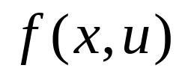


Mathematical Formulation
Goal: to find values for the variables which are optimal with respect to a certain objective and given constraints.
Variables: x (state variables)
u (control variables)
Objective:
Equality Constraints:
Inequality Constraints:
For optimization to have feasible solution, the total number of variables must be greater than the number of equality constraints.

Slide 23
Mathematical Formulation
Number of Variables n, Number of Equations m
  if m = n:
  The problem is an algebraic problem => usually has one solution
  if m > n:
  The problem is overdetermined => usally cannot be solved
  if m < n:
  The problem is underconstrained => more than one solutions exist
Only in the last case, an actual optimization can take place.
Otherwise, the solution is already given by the equality constraints or no solution exists.

Slide 24



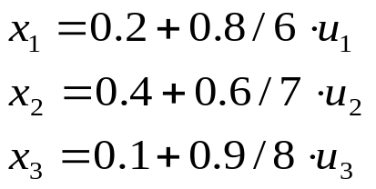
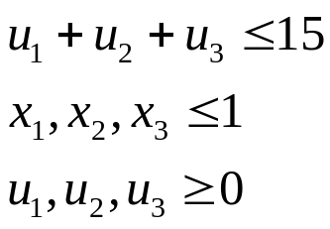
Mathematical Formulation
Example:
  Control Variables: Study time for each exam
  State Variables: Grades for each exam
  Objective Function: Avg. grade
  Equality Constraints:
  Learning Curves
  Inequality Constraints: max. overall study time
  max. grade for each exam
  min. study time each exam

Slide 25
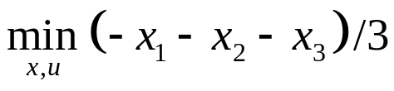
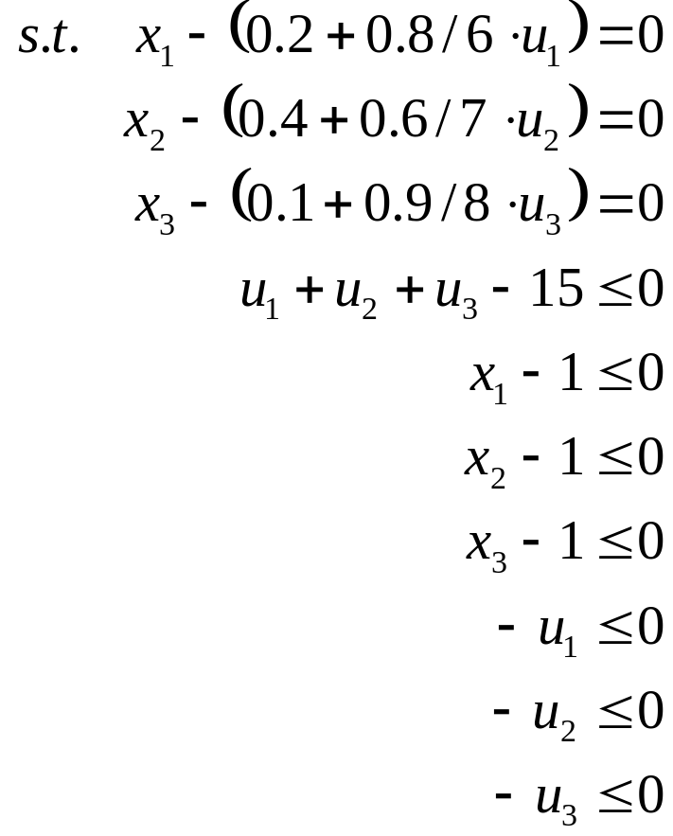
Mathematical Formulation
Example (cont.):

Slide 26
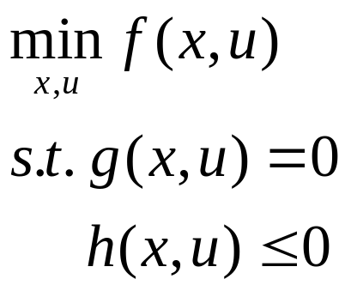
Mathematical Formulation
General Optimization Problem
Depending on the variables, the objective and the constraint functions, the optimization problems can be classified as
  Linear, quadratic or non-linear
  continuous or discrete
  constrained or unconstrained
  Convex or unconvex
  .......

Slide 27
Mathematical Formulation
Example: James, an SYSU student, opens a new sandwich shop on SYSU campus to earn some money. He offers two types of sandwiches, tuna and chicken. His costs for the tuna sandwich are ￥4, his profit is ￥ 3.5 and it takes him 8 minutes to make one. The costs for the chicken sandwich are ￥ 6, his profit is ￥ 3 and it takes him 6 minutes to make one. Besides studying, he is able to spend 3 hours per day preparing sandwiches and he has a budget of ￥ 120 per day. The university regulations say that he has to sell at least 5 sandwiches of each type.
Assuming that James can sell all his sandwiches, write down the optimization problem to find the number of sandwiches of each type which maximize his profit (don’t try to solve it).
Is this optimization problem
  linear, quadratic or nonlinear?
  continuous or discrete?
  constrained or unconstrained?

Slide 28
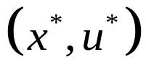
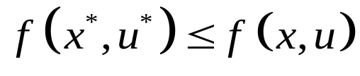


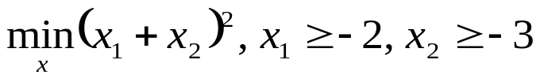

Mathematical Formulation
The solution of the optimization problem fulfills
for all
with
An optimization problem may
  be unsolvable due to conflicting constraints,
  e.g.
  have multiple solutions,
  e.g.
  have infinity as solution,
  e.g.

Slide 29
Applications
Cost minimization
Benefit maximization
Process optimization
Electricity market
Reliability optimization
Scheduling or planning
Effectiveness optimization
Data fitting
…

Slide 30
Applications
Requirements
  knowledge of the system/process/situation to be optimized and how to model it (no black or gray box problem)
  knowledge of optimization techniques
    Mathematical formulation
    Solution algorithm
  knowledge in computer programming (hand calculations become very tedious and even impossible)

Slide 31
Summary
Overview of energy system and smart grid
Components of an Optimization Problem
  Objective and
  Constraints (inequality & equality)
Mathematical Formulation
Applications

